Slide 1

Enhanced Flight Management System Using Max-Flow Algorithm
This presentation details our team's implementation of a flight management system using the Push-Relabel max-flow algorithm. We'll cover problem definition, algorithm design, analysis, and individual contributions to the project. Our system focuses on efficient passenger allocation, dynamic adjustments to flight capacity, and robust handling of flight cancellations and passenger re-routing.

Slide 2
Project Team
P Praveen
B Vijay Krishna
B Siva Sathwik
S Manish
Roll Number: cb.sc.u4cse23137
Roll Number: cb.sc.u4cse23112
Roll Number: cb.sc.u4cse23110
Roll Number: cb.sc.u4cse23125
Our team collaborated to build a comprehensive flight management system. Each member contributed specialized skills to ensure the project's success. Through diligent effort and collaborative problem-solving, we created an effective and dynamic solution for passenger allocation.

Slide 3
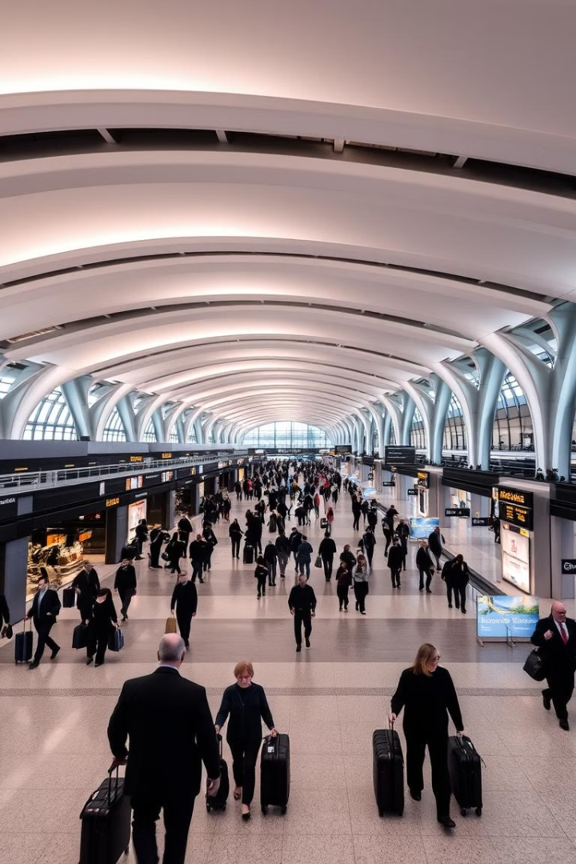
Problem Definition
Efficient Passenger Allocation
Dynamic Flight Management
Assign passengers to flights based on capacity and demand, maximizing the number of passengers flown.
Adapt to real-time changes such as flight cancellations and seat adjustments to minimize passenger disruption.
Waiting List and Refunds
Implement waiting lists and refund mechanisms to deal with passengers affected by changes.
The goal is to create a resilient and adaptable system that can handle various scenarios while optimizing resource utilization and passenger satisfaction. This involves efficiently managing flight capacities, passenger preferences and class, and potential disruptions with waiting lists and refunds.

Slide 4





Algorithm Design: Push-Relabel
Initialization
Set initial heights and excess flows. Push flow from source to neighbors.
Push Operation
Move excess flow from a node to a neighbor with lower height if capacity allows.
Relabel Operation
Increase a node's height if it has excess flow but cannot push to any neighbor.
Repeat
Continue pushing and relabeling until no more flow can be pushed.
The Push-Relabel algorithm is used to determine the maximum flow of passengers through the flight network. Nodes represent flights, and edges represent passenger flow paths. The algorithm iteratively pushes flow and adjusts node heights to efficiently find the optimal passenger allocation, adapting as flights are cancelled or capacity changes.

Slide 5
Graph Construction
Nodes
Edges
Source (All passengers)
Source to Flights (passenger limits)
Flights
Flights to Capacity Nodes (seat availability)
Capacity Nodes
Capacity Nodes to Sink
Sink (Completed trips)
The graph represents the flight network. Each flight is a node, and the edges represent the capacity of passengers that can be allocated. The source node represents all passengers, and the sink node represents passengers who have completed their trips. The edges from flights to capacity nodes enforce seating limits. Connecting flights are additional nodes linked to the primary flight paths.

Slide 6




Passenger Allocation & Flight Management
Dynamic Capacity Adjustments
Flight Cancellation Handling
Waiting Lists
Manage waiting lists for fully booked flights, prioritizing re-allocation.
Handle changes in seat availability due to maintenance or other factors.
Reallocate passengers from canceled flights to available alternatives.
The system allows for real-time adjustments to flight capacity and automatic reallocation of passengers in the event of cancellations. Waiting lists prioritize passengers for reallocation, and refund mechanisms ensure fair treatment. These features enhance the robustness and adaptability of the system to handle unpredictable events.

Slide 7

Analysis: Time Complexity
Operation
Complexity
Push
O(1)
Relabel
O(V)
Overall Push-Relabel
O(V^2 * E)
Passenger Reallocation
O(N * log N)
The Push-Relabel algorithm has a time complexity of O(V^2 * E), where V is the number of vertices (flights) and E is the number of edges (connections). The passenger reallocation process involves sorting available flights, leading to a complexity of O(N * log N), where N is the number of available flights. Adjusting seats and canceling flights are O(1) operations, excluding the reallocate procedure.

Slide 8
Code Snippet: Max-Flow Implementation
def max_flow(graph, source, sink): flow = 0 while True: path = find_path(graph, source, sink) if not path: break # Calculate bottleneck capacity bottleneck = min(graph[u][v]['capacity'] for u,v in path) # Update residual capacities for u,v in path: graph[u][v]['capacity'] -= bottleneck graph[v][u]['capacity'] += bottleneck flow += bottleneck return flow def find_path(graph, source, sink): # Implementation of BFS or DFS to find a path pass
This Python code snippet illustrates a simplified version of the Max-Flow algorithm. The max_flow function calculates the maximum possible flow from a source to a sink in a given graph. It uses a helper function find_path to locate paths with available capacity, iteratively updating residual capacities until no more paths can be found.

Slide 9
Code Snippet: Find Path Implementation
def find_path(graph, source, sink):
queue = [(source, [source])]
visited = set()
while queue:
(node, path) = queue.pop(0)
if node == sink:
return path
if node not in visited:
visited.add(node)
for neighbor in graph[node]:
if graph[node][neighbor]['capacity'] > 0:
queue.append((neighbor, path + [neighbor]))
return None
This Python code snippet illustrates a simplified version of the `find_path` function, used within the Max-Flow algorithm. The function performs a Breadth-First Search (BFS) to locate a path from the source to the sink in a given graph. It explores nodes while checking for available capacity, and returns a valid path if one exists; otherwise, it returns `None`.

Slide 10
Expected Output of Max-Flow Implementation
Upon execution, the Max-Flow algorithm provides two key outputs:
Maximum Flow Value: This numerical value represents the highest possible flow that can be routed from the source to the sink node in the graph. In the context of flight management, this indicates the maximum number of passengers or resources that can be optimally allocated through the flight network.
Updated Residual Graph: The algorithm modifies the original graph by updating the residual capacities of each edge. These updated capacities reflect the remaining available capacity on each flight route after the maximum flow has been achieved. Specifically:
Edges in the path of flow will have reduced capacity, indicating usage.
Reverse edges (from sink to source) will have increased capacity, indicating the possibility of reversing flow to find a more optimal solution.
These outputs together provide a comprehensive understanding of how resources can be optimally managed and allocated within the network, maximizing efficiency and resource utilization.

Slide 11





Individual Contributions
P Praveen
B Vijay Krishna
B Siva Sathwik
Graph Construction & Initialization
Push-Relabel Algorithm Implementation
Passenger Allocation & Flight Management
S Manish
Main Function & Visualization
Each team member had a specific role to play in this project. P Praveen designed and initialized the graph structure. B Vijay Krishna implemented the core Push-Relabel algorithm. B Siva Sathwik managed passenger allocation and flight dynamics, and S Manish handled the main function and ensured the system's visualization.

Slide 12

Key Takeaways & Future Steps
1
Efficient Max-Flow Solution
Successfully implemented the Push-Relabel algorithm for optimized passenger allocation.
2
Dynamic System
Created a system that adapts to changes, such as flight cancellations and seat adjustments.
3
Further Optimization
Explore heuristics to reduce memory and time complexity.
4
Enhanced Features
Incorporate real-world constraints, such as connecting flights and multi-class tickets.
Our project demonstrates the effective application of the Push-Relabel algorithm in a dynamic flight management system. Future steps involve enhancing the model with real-world flight booking complexities such as connecting flights and class upgrades. This allows for handling of refund processes more clearly.

